Slide 1
Machine Learning (Introduction)

Slide 2
Contents
Introduction
Applications
Types of Machine Learning
Conclusions

Slide 3
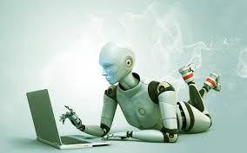
Introduction
Machine learning:
Grew out of work in AI
New capability for computers
Field of study that gives computers ability to learn
Notes:
I

Slide 4
Introduction
Arthur Samuel (1959). Machine Learning: Field of
study that gives computers the ability to learn without being explicitly programmed.
Now what is meant by computers ability to learn
Tom Mitchell (1998): A computer program is said to learn from experience E with respect to some task T and some performance measure P, if its performance on T, as measured by P, improves with E

Slide 5
Example
Suppose your email program watches which emails you do or do not mark as spam, and based on that learns how to better filter spam. What is the task T in this setting?
Classifying emails as spam or not spam.
Watching you label emails as spam or not spam.
The number (or fraction) of emails correctly classified as spam/not spam.
None of the above—this is not a machine learning problem.

Slide 6

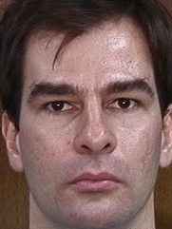
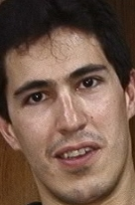


Example
Task: Face Recognition
Experience: Images or Examples
Performance Measure: Accuracy
Training Data
??

Slide 7
Some Applications
predict whether a patient, hospitalized due to heart attack, will have a second heart attack
predict the price of a stock in 6 months from now
Autonomous helicopter, handwriting recognition, most of
Natural Language Processing (NLP), Computer Vision.
Personalized Medicine
face detection, spam filtering: identify email messages as spam or non-spam
Self-customizing programs: E.g., Amazon, Netflix product recommendations

Slide 8
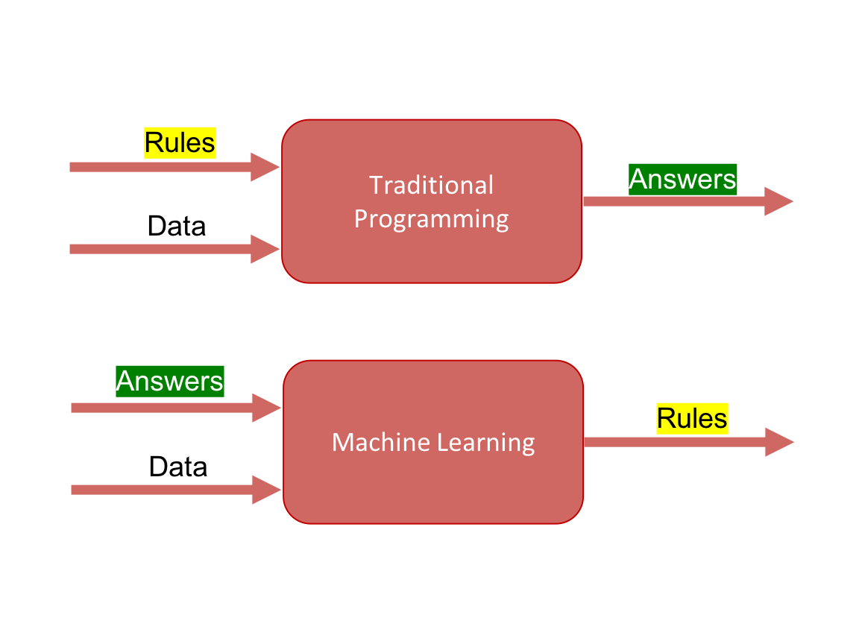
ML Vs. TP

Slide 9


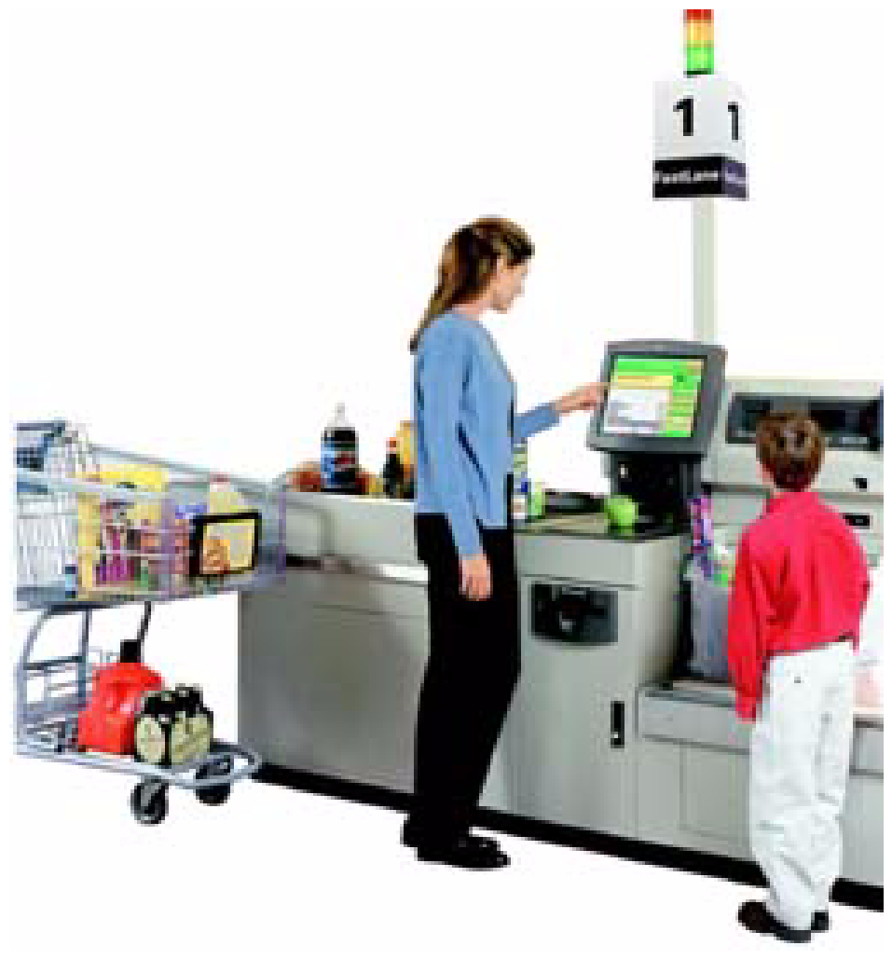
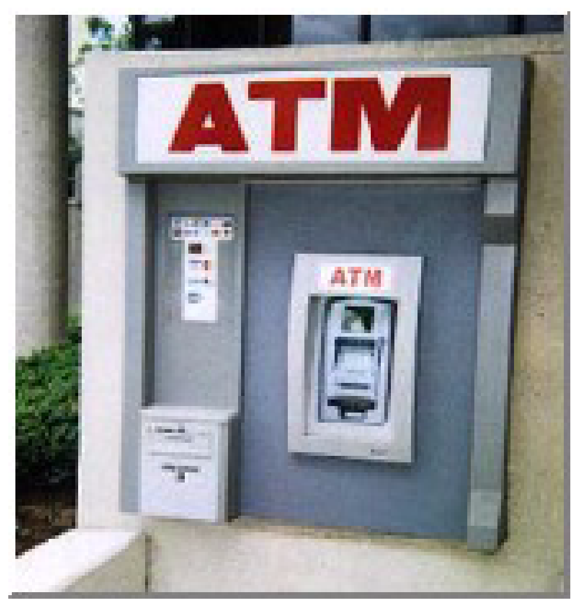
Why Mine Data? Commercial Viewpoint
Lots of data is being collected and warehoused
Web data, e-commerce
purchases at department/ grocery stores
Bank/Credit Card transactions
Computers have become cheaper and more powerful
Notes:
Before I discuss some applications, I would like to mention that we are using learning methods in our daily life without knowing it. e.g. Royal mail service recognize the postal code i.e. Character recognition using learning methods; so everything u send mail; u are using learning algorithms; perhaps even not aware of it. Another example is when we use websites such as amazon they often recommend books to buy or CDs to buy. This is another example of learning algorithm that tries to learn what are u interested on; what sort of movies would u like to watch and thus customize recommendation according to that.

Slide 10
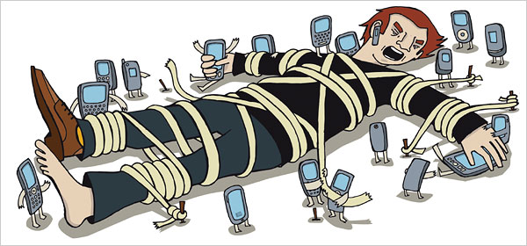
Data Everywhere
Notes:
Before I discuss some applications, I would like to mention that we are using learning methods in our daily life without knowing it. e.g. Royal mail service recognize the postal code i.e. Character recognition using learning methods; so everything u send mail; u are using learning algorithms; perhaps even not aware of it. Another example is when we use websites such as amazon they often recommend books to buy or CDs to buy. This is another example of learning algorithm that tries to learn what are u interested on; what sort of movies would u like to watch and thus customize recommendation according to that.

Slide 11
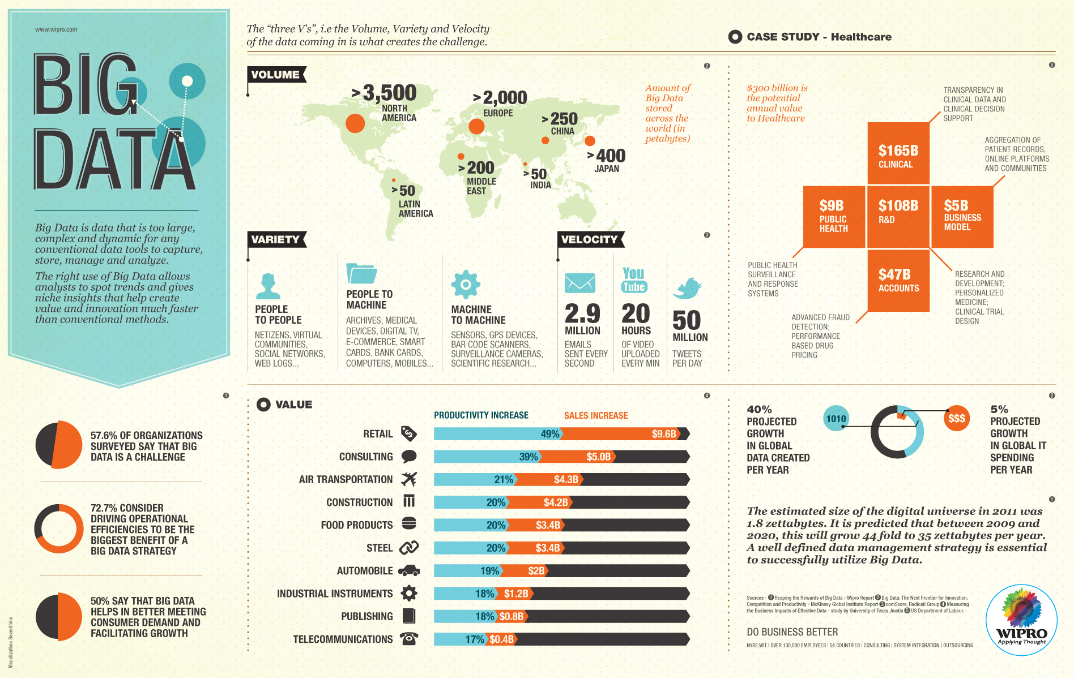

Slide 12
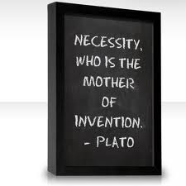
OK , there is too much Data, then WHAT?
Can we use this data to find things that are not apparent but can be very useful to us?
We are drowning in data, but starving for knowledge!
Knowledge Discovery is needed to make sense and use of data.

Slide 13
Types of Machine Learning
Machine Learning
Supervised
Unsupervised
Reinforcement
Regression
Classification

Slide 14
Learning Pipeline
Dataset
Training Set
Learning Algorithm
Test Set
Hypothesis
Prediction

Slide 15
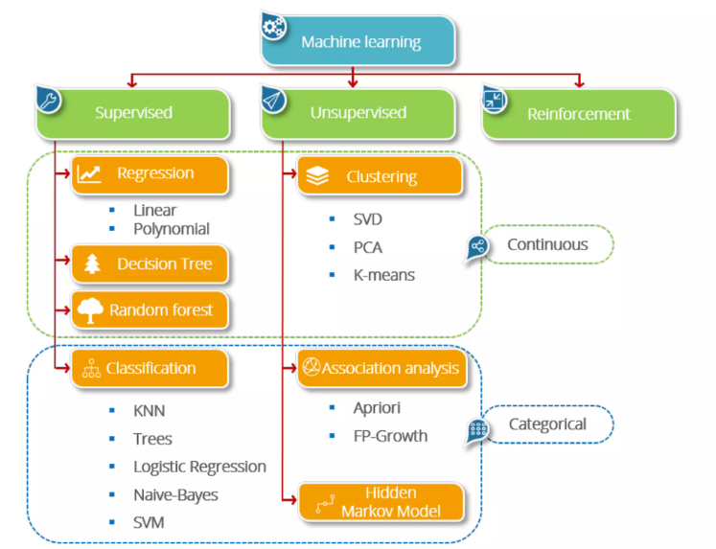

Slide 16
Prediction vs Interpretation
It is always a trade-off
If the goal is high accuracy(e.g. Spam filter) then we do not care ‚why‘ and ‚how‘ the model reaches it
If the goal is interpretability(e.g. In Biology, SNPs which predict a certain disease risk) then we care ‚why‘ and ‚how‘

Slide 17
Supervised Learning
Supervised Learning
Where the model is trained on labeled data to make predictions or classify new data.
For example; spam filtering where Large number of email messages labelled as either
spam
non-spam
New email message will then be classified as spam or non-spam
Notes:
Machine Learning method able to extract rules from this data

Slide 18
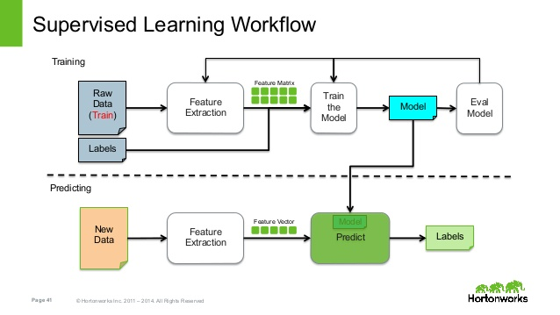
Notes:
Machine Learning method able to extract rules from this data

Slide 19
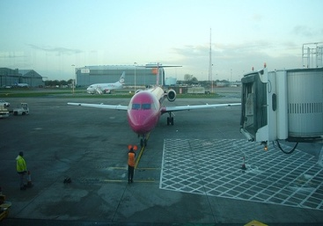
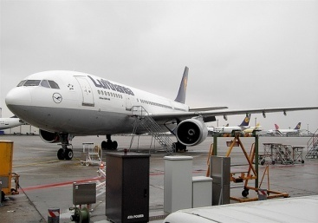
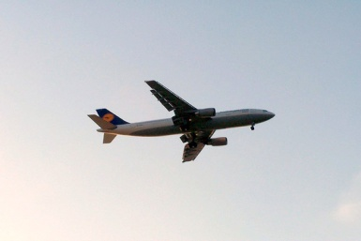



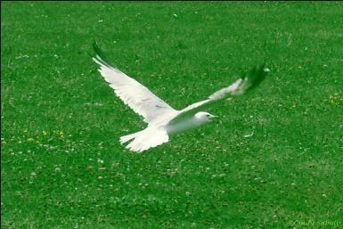
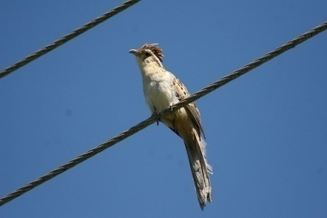

Supervised Learning
Training Images
Test Image
Notes:
Machine Learning method able to extract rules from this data

Slide 20
Unsupervised Learning
Where the model is trained on unlabeled data to find patterns or relationships in the data.
Applications
Fraud Detection: Identify groups of motor insurance policy holders with a high average claim cost
Social Networks: Recognize communities within large groups of people

Slide 21
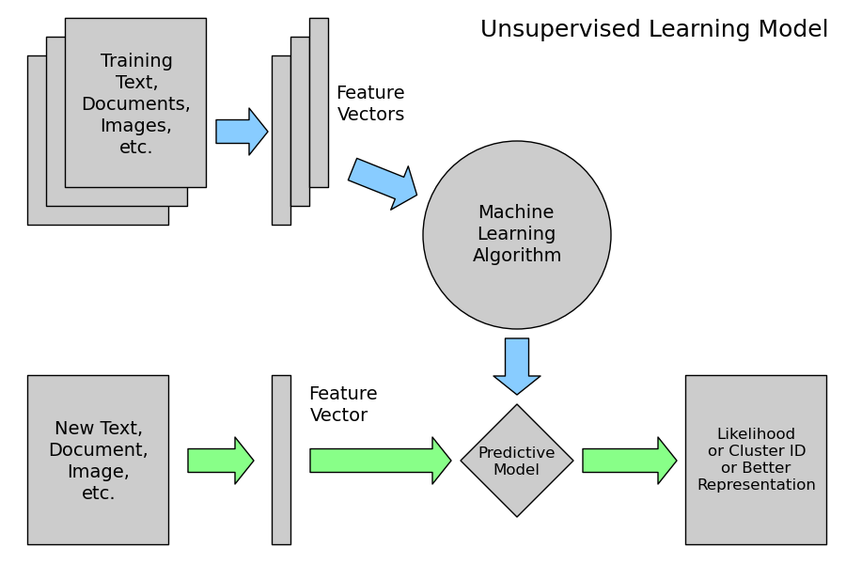
Unsupervised Learning

Slide 22
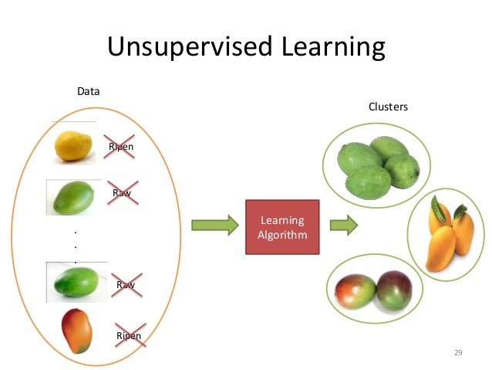
Unsupervised Learning

Slide 23

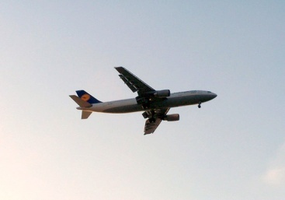


Unsupervised Learning
Objective is simply to divide above Images into N groups
Here ideally N = 2
Notes:
Here the method can also assum other groups e.g. Group with one object or group with multiple objects

Slide 24
Reinforcement Learning
Where the model is trained by learning from the consequences of its actions in an environment.
Applications:
Robotics: Reinforcement learning is being used to train robots to perform tasks such as grasping objects or navigating through environments.
Gaming: Reinforcement learning has been used to train AI agents to play video games, such as ATARI games, to a superhuman level.
Autonomous vehicles:

Slide 25

Reinforcement Learning Workflow

Slide 26
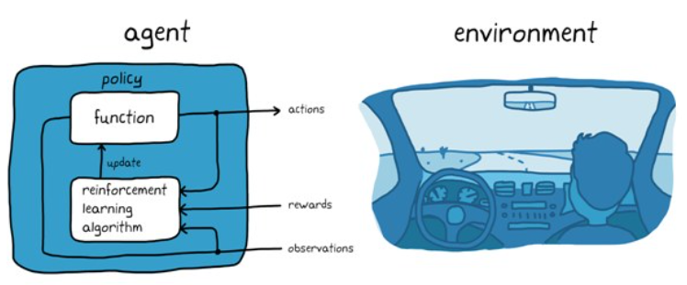
Reinforcement learning in autonomous parking

Slide 27
Tools
Java (WEKA)
MATLAB
C++
Python (scikit-learn)
Apache Spark (For Clouds)
R
Notes:
Computer Vision e.g. Face detection, Image Retrieval
Biomedical e.g. Diagnose a patient with a disease
Finance e.g. Credit Card Transactions which may be suspecious in nature
Computer Games e.g. Play with Computers e.g. Chess
Mobile Application Development: e.g. Replacing 4 digit security key with Biometric; develop applications to identify certain disease etc

Slide 28

WHAT IS THIS COURSE ALL ABOUT ?

Slide 29
Course Description
This course is about gaining an understanding of machine learning problems and their solutions.
This course will not only provide the students a comprehension of the benefits of machine learning, but also provide them with an understanding of the types of problems and their associated solutions.
It will also impart them skills for pre-processing of data and post-processing of results.

Slide 30
Course Main Learning Objectives
The students should have a thorough knowledge of the working and steps of various important algorithms used in machine learning.
the student would be able to effectively applying machine learning methods to a variety of real-world problems related to medical, fintech, and cyber security (but not limited to these only).

Slide 31
HOW WILL BE GRADING DONE? : THE Grading Scheme
Midterm 30%
Project & Presentation 10%
Quiz & Assignments 10%
Final 50%

Slide 32
Final Remarks
12 IT skills that employers can't say no to (ComputerWorld)
Number one is Machine Learning
“There are lots of applications that have big, big, big data sizes, which creates a fundamental problem of how you organize the data and present it to users”
Notes:
Computer Vision e.g. Face detection, Image Retrieval
Biomedical e.g. Diagnose a patient with a disease
Finance e.g. Credit Card Transactions which may be suspecious in nature
Computer Games e.g. Play with Computers e.g. Chess
Mobile Application Development: e.g. Replacing 4 digit security key with Biometric; develop applications to identify certain disease etc

Slide 33
Questions!

